Slide 1
CSCC43 Tutorial 10
2021 July 27
Slide Design from Slides Carnival

Slide 2

Lossy Join Decomposition
Suppose we have a relation with attributes cdf, name, grade. Here is an instance of that relation:
cdf | name | grade
g3tout | Amy | 91
g4boobar | David | 78
c0zhang | David | 85
Suppose we were to decompose this into two new relations: $R1$ (cdf, name) and $R2$ (name, grade).
Project the data onto those two new relations.
Then compute $R1⋈R2$ to rebuild the original table.

Slide 3

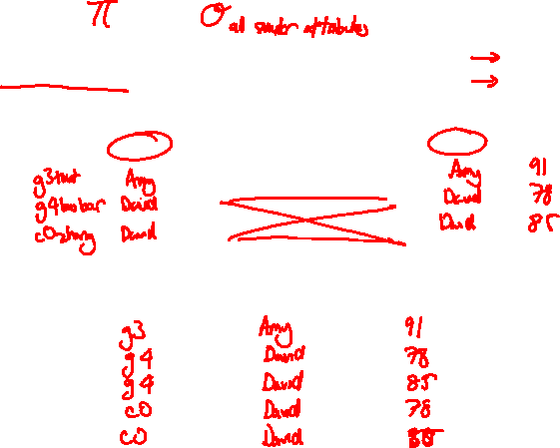
Lossy Join Decomposition
cdf | name | grade
g3tout | Amy | 91
g4boobar | David | 78
c0zhang | David | 85
cdf | name
name | grade
$$⋈$$
cdf | name | grade

Slide 4
Lossy Join Decomposition
cdf | name | grade
g3tout | Amy | 91
g4boobar | David | 78
c0zhang | David | 85
cdf | name
name | grade
$$⋈$$
cdf | name | grade

Slide 5

First Normal Form (1NF)
Every cell in the relation takes on only a single value (is indivisible).
SID | Major
1234567890 | Computer Science, Mathematics
SID | Major
1234567890 | Computer Science
1234567890 | Mathematics

Slide 6
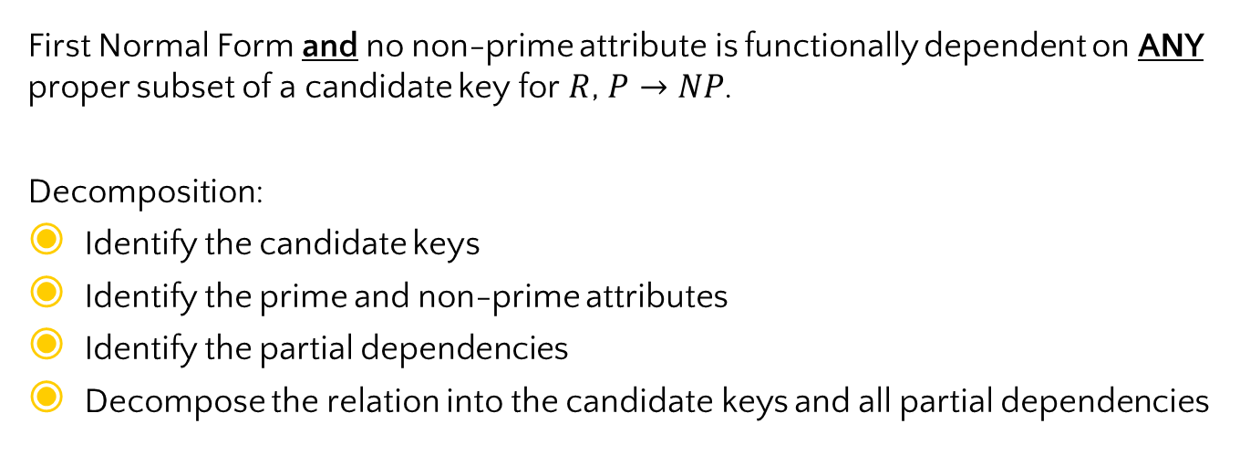
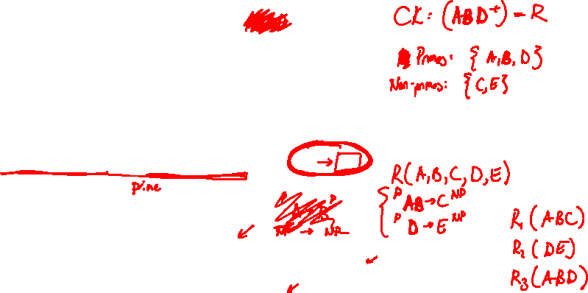
Second Normal Form (2NF)
First Normal Form and no non-prime attribute is functionally dependent on ANY proper subset of a candidate key for $R$, $P→NP$.
Decomposition:
Identify the candidate keys
Identify the prime and non-prime attributes
Identify the partial dependencies
Decompose the relation into the candidate keys and all partial dependencies

Slide 7
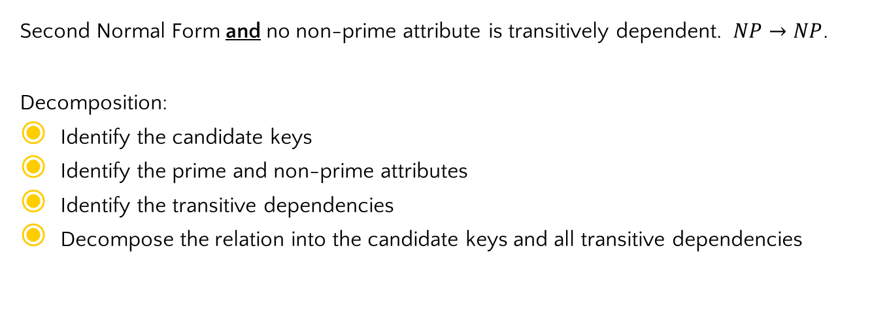
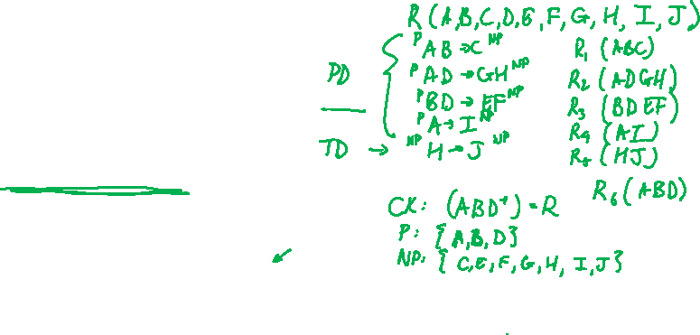
Third Normal Form (3NF)
Second Normal Form and no non-prime attribute is transitively dependent. $NP→NP$.
Decomposition:
Identify the candidate keys
Identify the prime and non-prime attributes
Identify the transitive dependencies
Decompose the relation into the candidate keys and all transitive dependencies

Slide 8
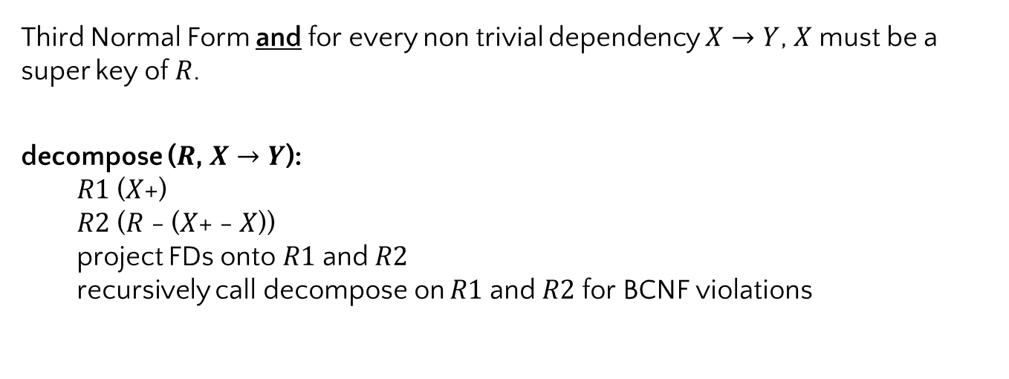
Boyce-Codd Normal Form ( BCNF / 3.5NF )
Third Normal Form and for every non trivial dependency $X→Y$, $X$ must be a super key of $R$.
decompose ($R$, $X→Y$):
  $R1$ ($X$+)
  $R2$ ($R$ - ($X$+ - $X$))
  project FDs onto $R1$ and $R2$
  recursively call decompose on $R1$ and $R2$ for BCNF violations

Slide 9
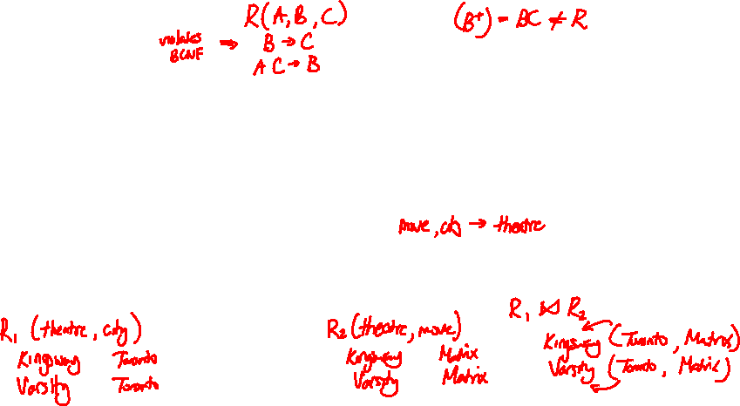
Boyce-Codd Normal Form ( BCNF / 3.5NF )
Suppose we have a relation with attributes (movie, theatre, city) and FDs { theatre → city; movie, city → theatre}. The FD theatre → city violates BCNF, and applying the BCNF decomposition algorithm, we get two new relations:
R1 (theatre, city) with one FD: theatre → city
R2 (theatre, movie) with no FDs
Create small instances of R1 and R2 that satisfy their own FDs, but when natural-joined together, violate one of the original FDs.

Slide 10
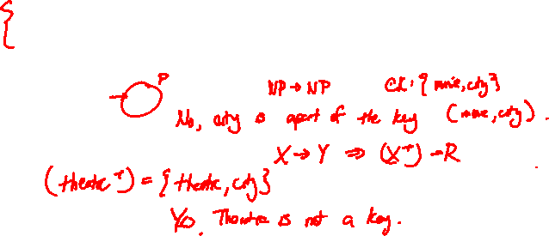
Boyce-Codd Normal Form ( BCNF / 3.5NF )
Suppose we have a relation with attributes (movie, theatre, city) and FDs
theatre → city
movie, city → theatre
Does theatre → city violate 3NF?
Does theatre → city violate BCNF?

Slide 11
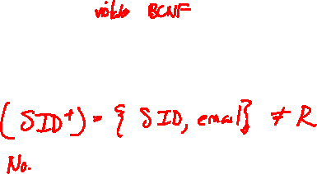
Boyce-Codd Normal Form ( BCNF / 3.5NF )
Suppose we have a relation Students (SID, email, course, term, prof), and that these FDs hold:
SID → email
course, term → prof
SID, course → grade
Is this relation in BCNF?

Slide 12
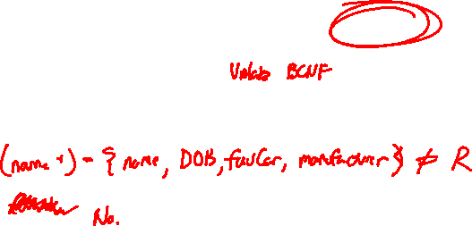
Boyce-Codd Normal Form ( BCNF / 3.5NF )
Suppose we have a relation Customers (name, DOB, address, favouriteCar, manufacturer) and these FDs hold:
name → DOB, favouriteCar
favouriteCar → manufacturer
Is this relation in BCNF?

Slide 13
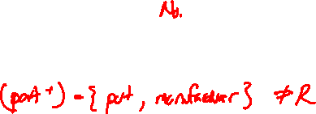
Boyce-Codd Normal Form ( BCNF / 3.5NF )
Suppose we have a relation Parts (part, manufacturer, seller, price) and these FDs hold:
part → manufacturer
part, seller → price
Is this relation in BCNF?

Slide 14
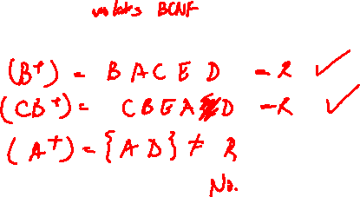
Boyce-Codd Normal Form ( BCNF / 3.5NF )
Suppose we have a relation R(A, B, C, D, E) and these FDs hold:
B → AC
CB → E
A → D
Is this relation in BCNF?

Slide 15
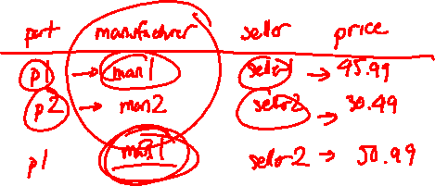
Boyce-Codd Normal Form ( BCNF / 3.5NF )
Consider the relation: Parts(part, manufacturer, seller, price) with these FDs:
part → manufacturer
part, seller → price
Keeping in mind the FDs, make an instance of this relation that has redundant information.

Slide 16
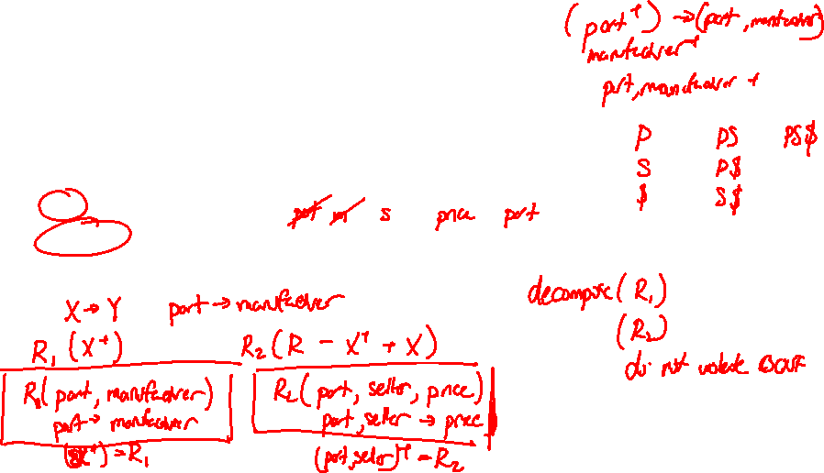
Boyce-Codd Normal Form ( BCNF / 3.5NF )
Consider the relation: Parts(part, manufacturer, seller, price) with these FDs:
part → manufacturer
part, seller → price
If we applied the decomposition step from BCNF decomposition, what attributes would each of the new relations have?

Slide 17

Boyce-Codd Normal Form ( BCNF / 3.5NF )
Consider the relation: Parts(part, manufacturer, seller, price) with these FDs:
part → manufacturer
part, seller → price
Project the FDs onto each of the new relations

Slide 18
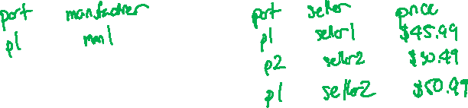
Boyce-Codd Normal Form ( BCNF / 3.5NF )
Consider the relation: Parts(part, manufacturer, seller, price) with these FDs:
part → manufacturer
part, seller → price
Put the same data as in part (a) into your new schema. Is there any redundancy?

Slide 19
Boyce-Codd Normal Form ( BCNF / 3.5NF )
Consider the relation: Parts(part, manufacturer, seller, price) with these FDs:
part → manufacturer
part, seller → price
Is it possible to create redundancy with this new schema?

Slide 20
Thanks!
Any questions ?
You can find me at
ta.kthisiscvpv.com
charles.xu@mail.utoronto.ca

