Slide 1

CSCC43 Tutorial 2
2021 May 25
Slide Design from Slides Carnival

Slide 2
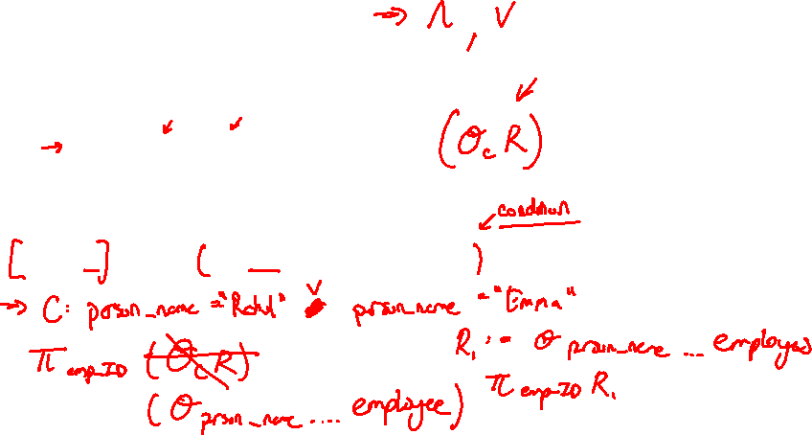
Question 4
Schema 2:
  employee (emp_ID, person_name)
  company (company_name, rank)
  roster (emp_ID, company_name, salary, city)
  roster [emp_ID] ⊆ employee [emp_ID]
  roster [company_name] ⊆ company [company_name]
Find all the IDs of all employees with the name “Rahul” or with the name “Emma”.

Slide 3
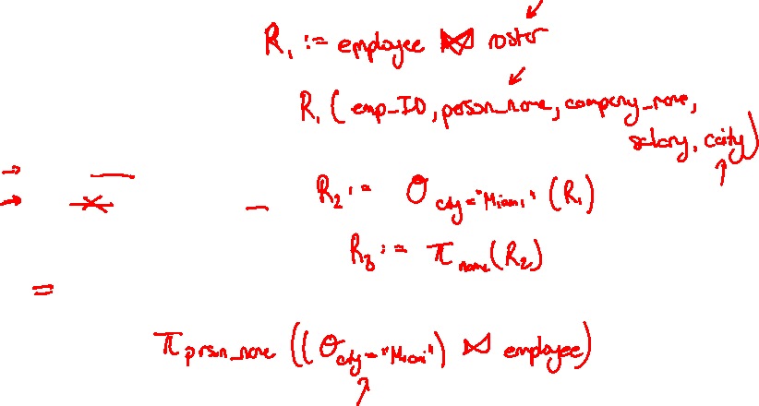
Question 5
Schema 2:
  employee (emp_ID, person_name)
  company (company_name, rank)
  roster (emp_ID, company_name, salary, city)
  roster [emp_ID] ⊆ employee [emp_ID]
  roster [company_name] ⊆ company [company_name]
Find the name of each employee who lives in city Miami.

Slide 4
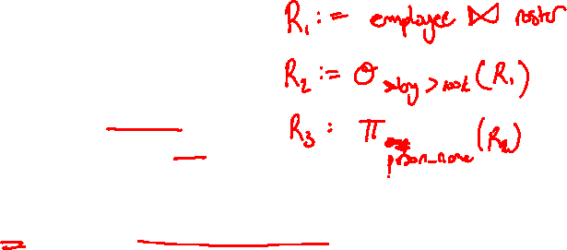
Question 6
Schema 2:
  employee (emp_ID, person_name)
  company (company_name, rank)
  roster (emp_ID, company_name, salary, city)
  roster [emp_ID] ⊆ employee [emp_ID]
  roster [company_name] ⊆ company [company_name]
Find the name of each employee whose salary is greater than $100,000.

Slide 5
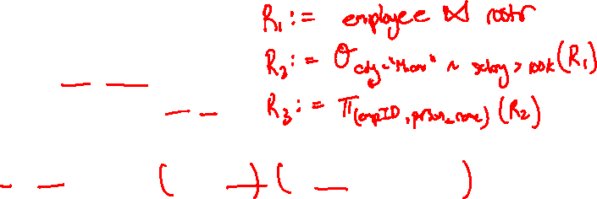
Question 7
Schema 2:
  employee (emp_ID, person_name)
  company (company_name, rank)
  roster (emp_ID, company_name, salary, city)
  roster [emp_ID] ⊆ employee [emp_ID]
  roster [company_name] ⊆ company [company_name]
Find the ID and names of each employee who lives in Miami and whose salary is greater than $100,000.

Slide 6
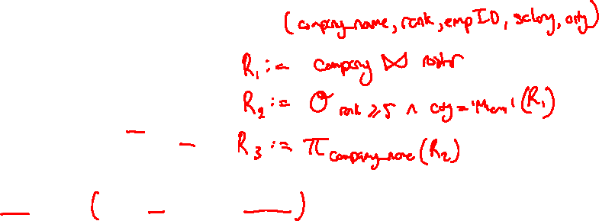
Question 8
Schema 2:
  employee (emp_ID, person_name)
  company (company_name, rank)
  roster (emp_ID, company_name, salary, city)
  roster [emp_ID] ⊆ employee [emp_ID]
  roster [company_name] ⊆ company [company_name]
Find the names of companies that have a rank of at least 5 and are in Miami.

Slide 7
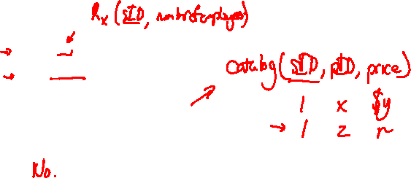
Question 9
Schema 3:
  suppliers (sID, sName, address)
  parts (pID, pName, colour)
  catalog (sID, pID, price)
  catalog [sID] ⊆ suppliers [sID]
  catalog [pID] ⊆ parts [pID]
If sID is a key for the suppliers relation, could it be a key for the catalog relation?

Slide 8
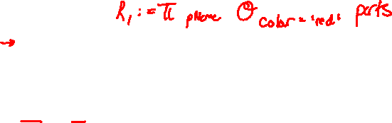
Question 10
Schema 3:
  suppliers (sID, sName, address)
  parts (pID, pName, colour)
  catalog (sID, pID, price)
  catalog [sID] ⊆ suppliers [sID]
  catalog [pID] ⊆ parts [pID]
Find the names of all red parts.

Slide 9
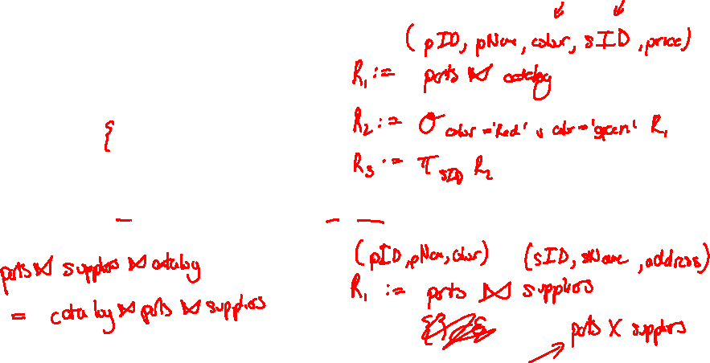
Question 11
Schema 3:
  suppliers (sID, sName, address)
  parts (pID, pName, colour)
  catalog (sID, pID, price)
  catalog [sID] ⊆ suppliers [sID]
  catalog [pID] ⊆ parts [pID]
Find the sIDs of all suppliers who supply a part that is red or green.

Slide 10
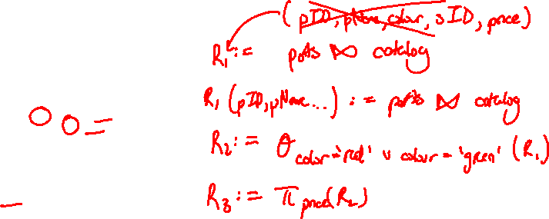
Question 12
Schema 3:
  suppliers (sID, sName, address)
  parts (pID, pName, colour)
  catalog (sID, pID, price)
  catalog [sID] ⊆ suppliers [sID]
  catalog [pID] ⊆ parts [pID]
Find all prices for parts that are red or green.

Slide 11
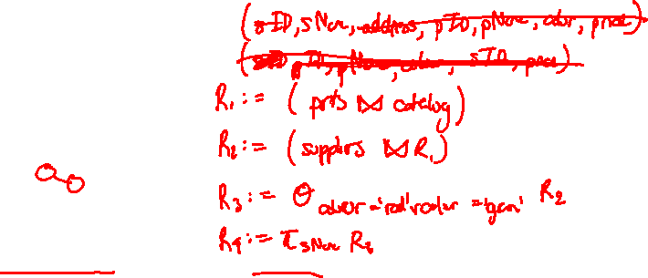
Question 13
Schema 3:
  suppliers (sID, sName, address)
  parts (pID, pName, colour)
  catalog (sID, pID, price)
  catalog [sID] ⊆ suppliers [sID]
  catalog [pID] ⊆ parts [pID]
Find the names of all suppliers who supply a part that is red or green.

Slide 12
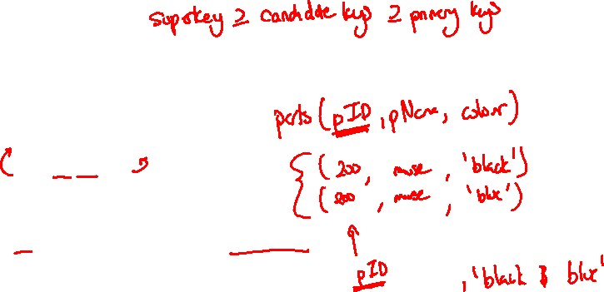
Question 14
Schema 3:
  suppliers (sID, sName, address)
  parts (pID, pName, colour)
  catalog (sID, pID, price)
  catalog [sID] ⊆ suppliers [sID]
  catalog [pID] ⊆ parts [pID]
Find the sIDs of all suppliers who supply a part that is red and green.

Slide 13
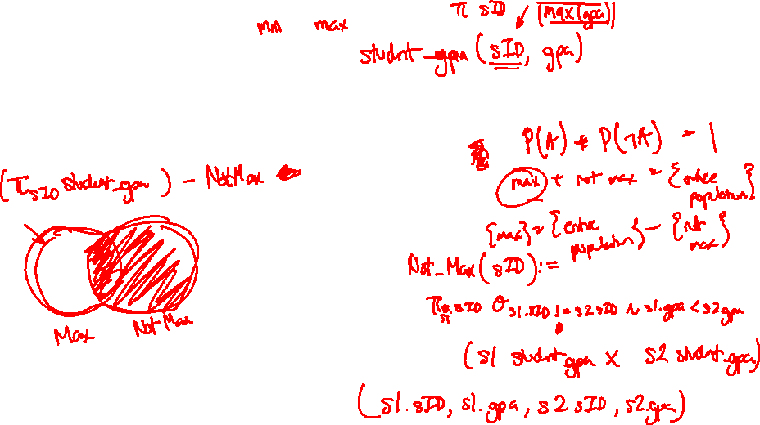
Thanks!
Any questions ?
You can find me at
ta.kthisiscvpv.com
charles.xu@mail.utoronto.ca

