Slide 1
CSCC43 Tutorial 5
2021 June 15
Slide Design from Slides Carnival

Slide 2

Review: Group By and Having
SELECT A FROM B GROUP BY C;
A: An aggregate function or a column that appears in C.
B: A relation.
C: Columns in Relation B to group the rows by.
Aggregate functions: AVG(), COUNT(), MAX(), MIN(), SUM()

Slide 3
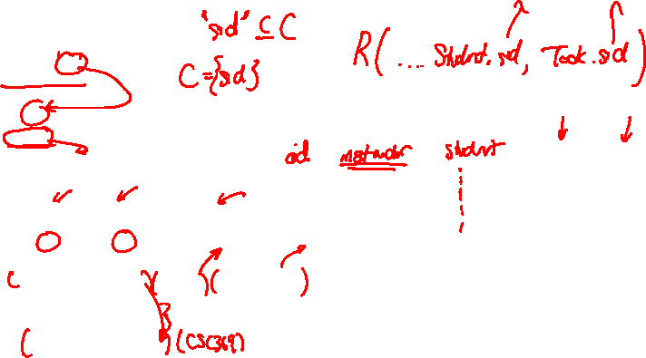
Question 1
Which of these queries is legal?
SELECT surname, sid
FROM Student, Took
WHERE Student.sid = Took.sid
GROUP BY sid;
SELECT surname, Student.sid
FROM Student, Took
WHERE Student.sid = Took.sid
GROUP BY campus;
SELECT instructor, max(grade), count(Took.oid)
FROM Took, Offering
WHERE Took.oid = Offering.oid
GROUP BY instructor;
SELECT Course.dept, Course.cnum, count(oid), count(instructor)
FROM Course, Offering
WHERE Course.dept = Offering.dept
AND Course.cnum = Offering.cnum
GROUP BY Course.dept, Course.cnum
ORDER BY count(oid);

Slide 4
Review: Group By and Having
SELECT * FROM Took;
sid | oid | grade
-------+-----+-------
99132 | 1 | 79
99132 | 16 | 98
99132 | 31 | 82
99132 | 11 | 99
99132 | 14 | 39
99132 | 15 | 62
99132 | 34 | 75
98000 | 11 | 79
... rows omitted

Slide 5

Review: Group By and Having
SELECT sid FROM Took GROUP BY sid;
sid
-------
98000
99132
11111
99999
157
sid | oid | grade
-------+-----+-------
99132 | 1 | 79
99132 | 16 | 98
99132 | 31 | 82
99132 | 11 | 99
99132 | 14 | 39
99132 | 15 | 62
99132 | 34 | 75

Slide 6
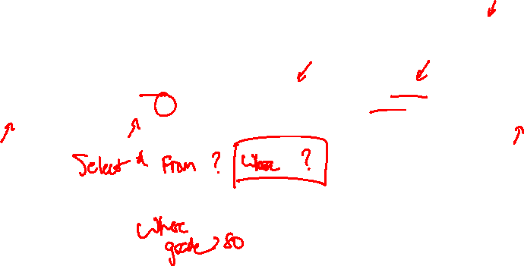
Review: Group By and Having
SELECT A FROM B WHERE C GROUP BY D HAVING E;

Slide 7

Question 2
Write a query to find the average grade, minimum grade, and maximum grade for each offering.
oid | avg | min | max
-----+---------------------+-----+-----
31 | 78.0000000000000000 | 70 | 82
34 | 60.6666666666666667 | 45 | 75
. . . rows omitted
8 | 92.0000000000000000 | 91 | 93
11 | 79.0000000000000000 | 39 | 99
(23 rows)

Slide 8
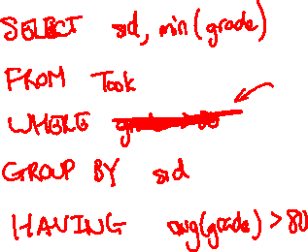
Question 3
Find the sid and minimum grade of each student with an average over 80.
sid | min
-------+-----
98000 | 54
99999 | 52
(2 rows)

Slide 9
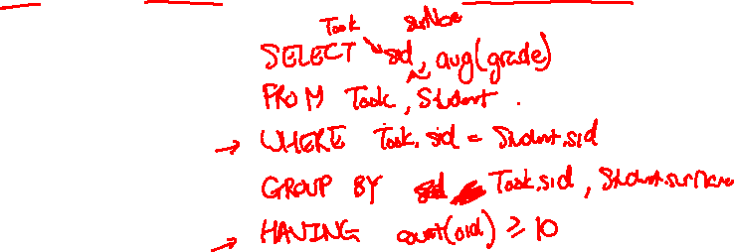
Question 4
Find the sid, surname, and average grade of each student, but keep the data only for those students who have taken at least 10 courses.
sid | surname | avg
-------+------------+---------------------
157 | Lakemeyer | 75.9333333333333333
99999 | Ali | 84.5833333333333333
98000 | Fairgrieve | 83.2000000000000000
(3 rows)

Slide 10
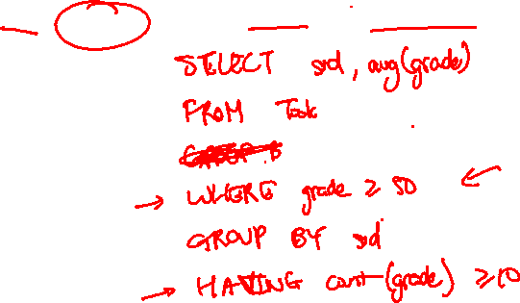
Question 5
For each student who has passed at least 10 courses, report their sid and average grade on the courses that they passed.
sid | avg
-------+---------------------
98000 | 83.2000000000000000
99999 | 84.5833333333333333
157 | 78.5714285714285714
(3 rows)

Slide 11
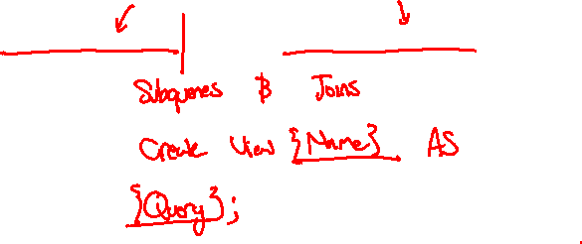
Question 6
For each student who has passed at least 10 courses, report their sid and average grade on all of their courses.
sid | avg
-------+---------------------
98000 | 83.2000000000000000
99999 | 84.5833333333333333
157 | 75.9333333333333333
(3 rows)

Slide 12
Thanks!
Any questions ?
You can find me at
ta.kthisiscvpv.com
charles.xu@mail.utoronto.ca

