Slide 1
CSCC43 Tutorial 6 2021 June 29
Slide Design from Slides Carnival

Slide 2
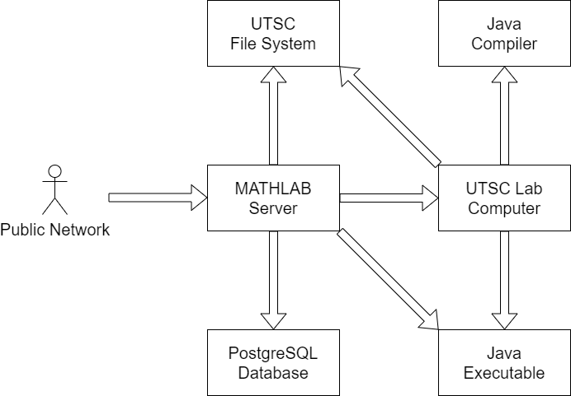
UTSC Network Architecture
Problem: MATHLAB cannot compile Java.
Problem: Lab computers cannot access
MATHLAB’s PostgreSQL server.

Slide 3
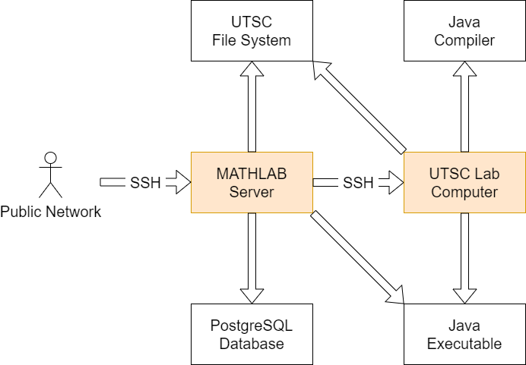
UTSC Network Architecture
We will establish 2 connections.
One to MATHLAB.
One to a UTSC Lab Computer through MATHLAB.
Hostnames:
mathlab.utsc.utoronto.ca
iits-b473-X.utsc-labs.utoronto.ca
$$X∈[01, 40]$$

Slide 4
Resources
Download PostgreSQL.
wget https://jdbc.postgresql.org/download/postgresql-42.2.5.jar

Slide 5
Commands
Compile your .java class.
javac -cp .:postgresql-42.2.5.jar *.java
Run your .class program.
java -cp .:postgresql-42.2.5.jar [main class] [arguments …]

Slide 6
Thanks!
Any questions ?
You can find me at
ta.kthisiscvpv.com
charles.xu@mail.utoronto.ca

