Slide 1
CSCC43 Tutorial 7 2021 July 6
Slide Design from Slides Carnival

Slide 2
Note: Assignment 2 Efficient JDBC Queries

Slide 3
Entity Relationship Diagrams

Slide 4
Entity Relationship Diagrams
|person| | |member| | |club| | Possible?
5 | 0 | 8 | Y / N
5 | 7 | 8 | Y / N
5 | 0 | 5 | Y / N
5 | 10 | 5 | Y / N
11 | 3 | 4 | Y / N
11 | 9 | 4 | Y / N

Slide 5
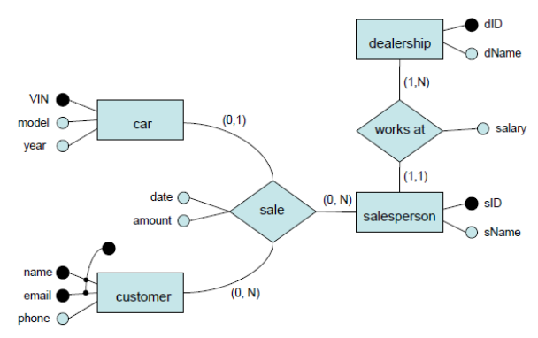
Entity Relationship Diagrams

Slide 6
Entity Relationship Diagrams
Q1: A car sale cannot involve more than one salesperson.
True / False

Slide 7
Entity Relationship Diagrams
Q2: There can be two cars with the same VIN if the model and year are different.
True / False

Slide 8
Entity Relationship Diagrams
Q3: A salesperson can work at any number of dealerships.
True / False

Slide 9
Entity Relationship Diagrams
Q4: There cannot be more salespeople than dealerships.
True / False

Slide 10
Entity Relationship Diagrams
Q5: There can be multiple sales on the same date.
True / False

Slide 11
Entity Relationship Diagrams
Q6: Two salespeople can have the same sID if they work at different dealerships.
True / False

Slide 12
Entity Relationship Diagrams
Q7: This model contains a weak entity set.
True / False

Slide 13
Entity Relationship Diagrams
Q8: The works at relationship is a one-to-many relationship.
True / False

Slide 14
Entity Relationship Diagrams
A university database contains information about professors (identified by SSN) and
courses (identified by course_id). Professors teach courses. Each of the following situations concerns
The Teaches relationship set. For each situation, draw an ER diagram that describes
it (assuming no further constraints hold).

Slide 15
Entity Relationship Diagrams
Professors can teach the same course in several semesters, and each offering must be recorded.

Slide 16
Entity Relationship Diagrams
Professors can teach the same course in several semesters, and only the most recent such offering
needs to be recorded (Assume this condition applies in all subsequent questions)

Slide 17
Entity Relationship Diagrams
Every professor must teach some course.

Slide 18
Entity Relationship Diagrams
Every professor teaches exactly one course (no more, no less)

Slide 19
Entity Relationship Diagrams
Every professor teaches exactly one course (no more, no less),
and every course must be taught by some professor.

Slide 20
Entity Relationship Diagrams
Now suppose that certain courses can be taught by a team of professors jointly,
but it is possible that no one professor in a team can teach the course. Model this
situation, introducing additional entity sets and relationship sets if necessary.

Slide 21
Thanks!
Any questions ?
You can find me at
ta.kthisiscvpv.com
charles.xu@mail.utoronto.ca

