Slide 1
CSCC43 Tutorial 8 2021 July 13
Slide Design from Slides Carnival

Slide 2
ER Diagrams: Continued
The Motor Vehicle Branch administers driving tests and issues driver's licenses. Any person who wants a driver’s license must first take a learner's exam at any Motor Vehicle Branch in the province. If he/she fails the exam, he can take the exam again any time after a week of the failed exam date, at any branch. If he passes the exam, he is issued a license (type = learner's) with a unique license number. A learner's license may contain a single restriction on it. The person may take his driver's exam at any branch any time before the learner's license expiry date (which is usually set at six months after the license issue date). If he passes the exam, the branch issues him a driver’s license. A driver's license must also record if the driver has completed driver's education, for insurance purposes. Draw an ER diagram that captures this information.

Slide 3
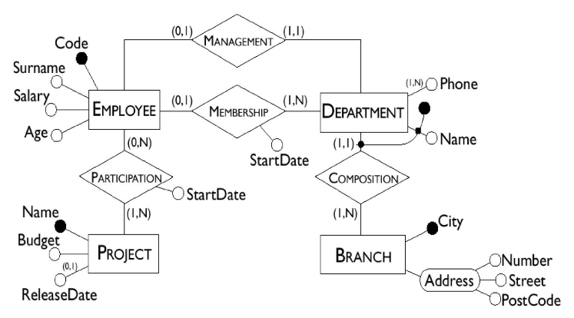
ER Diagrams: Continued
Consider the ER diagram:
Name a weak entity set in this diagram.
What attributes form a key for this entity set?
Can a department exist without a manager?
How many departments can an employee belong to?
How many of these kinds of relationships exist?
One to one relationship
One to many relationship
Many to many relationship

Slide 4
ER Diagrams: Continued
Consider the ER diagram:
Translate the ER diagram into a relational schema.

Slide 5
Thanks!
Any questions ?
You can find me at
ta.kthisiscvpv.com
charles.xu@mail.utoronto.ca

