Slide 1
CSCC43 Tutorial 9
2021 July 20
Slide Design from Slides Carnival

Slide 2
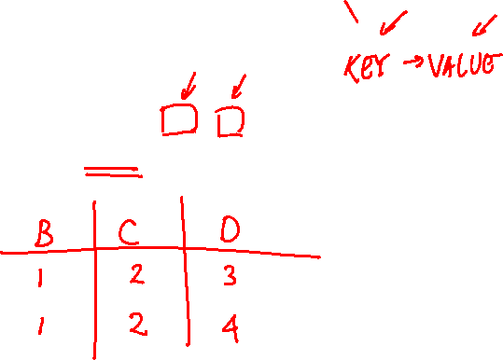
Functional Dependencies
Suppose the functional dependency BC →D holds in R.
Create an instance of R that violates this FD.

Slide 3

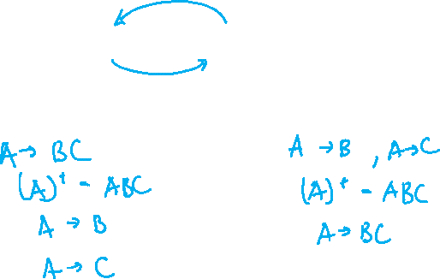
Functional Dependencies
Are the sets $A→BC$and $A→B$, $A→C$ equivalent?
If yes, explain why.
If no, construct an instance of R that satisfies one set of FDs but not the other.

Slide 4

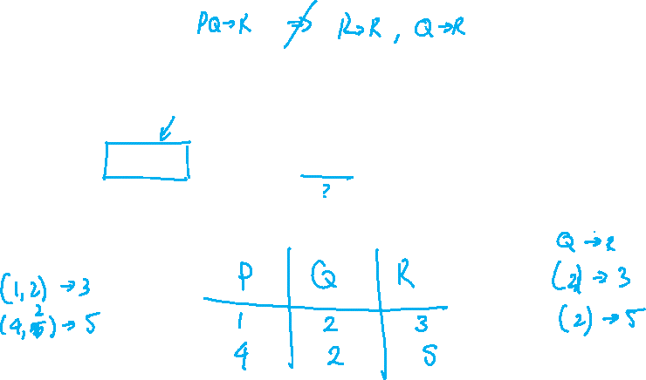
Functional Dependencies
Are the sets $PQ→R$and $P→R$, $Q→R$ equivalent?
If yes, explain why.
If no, construct an instance of R that satisfies one set of FDs but not the other.

Slide 5

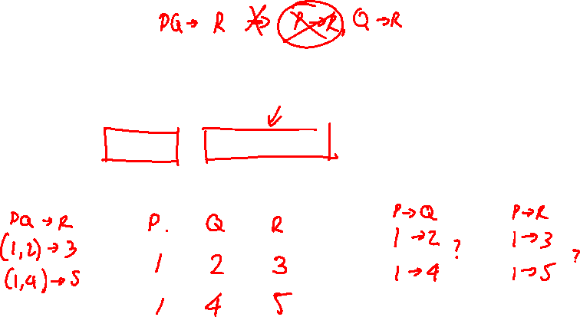
Functional Dependencies
Are the sets $PQ→R$and $P→Q$, $P→R$ equivalent?
If yes, explain why.
If no, construct an instance of R that satisfies one set of FDs but not the other.

Slide 6

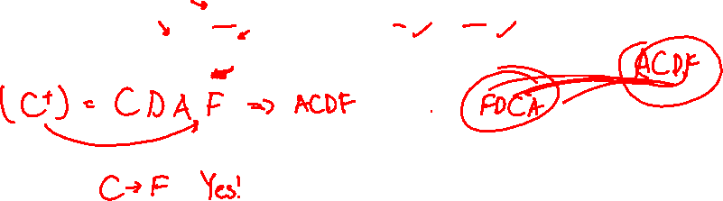
Functional Dependencies
Suppose we have a relation with attributes $ABCDEF$ with these FDs:
$AC→F$, $CEF→B$, $C→D$, $DC→A$
Does it follow that $C→F$ ?

Slide 7

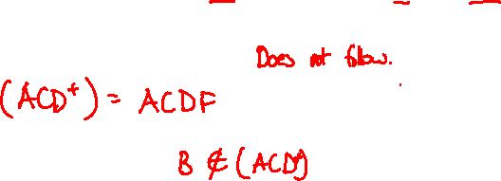
Functional Dependencies
Suppose we have a relation with attributes $ABCDEF$ with these FDs:
$AC→F$, $CEF→B$, $C→D$, $DC→A$
Does it follow that $ACD→B$ ?

Slide 8
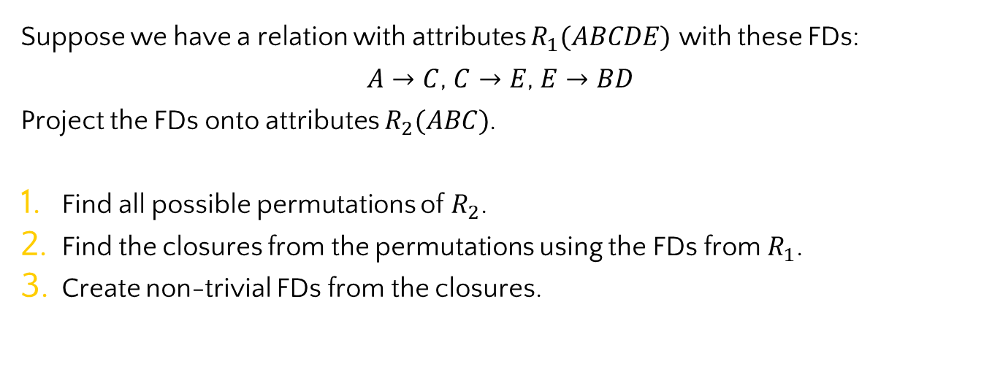
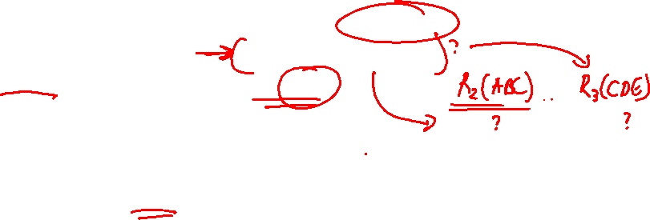
Projection
Suppose we have a relation with attributes $R_{1}(ABCDE)$ with these FDs:
$A→C$, $C→E$, $E→BD$
Project the FDs onto attributes $R_{2}(ABC)$.
Find all possible permutations of $R_{2}$.
Find the closures from the permutations using the FDs from $R_{1}$.
Create non-trivial FDs from the closures.

Slide 9

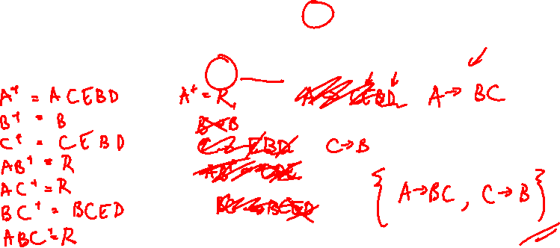
Projection
Suppose we have a relation with attributes $R_{1}(ABCDE)$ with these FDs:
$A→C$, $C→E$, $E→BD$
Project the FDs onto attributes $R_{2}(ABC)$.

Slide 10

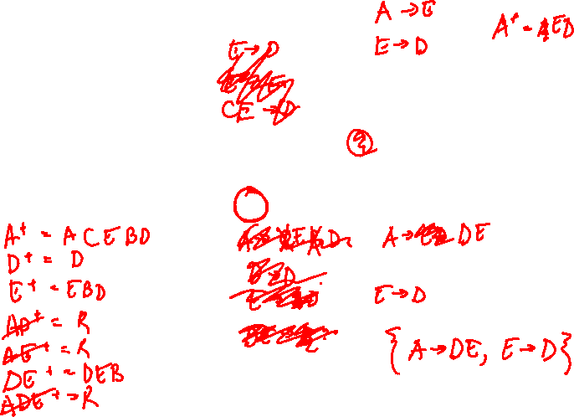
Projection
Suppose we have a relation with attributes $R_{1}(ABCDE)$ with these FDs:
$A→C$, $C→E$, $E→BD$
Project the FDs onto attributes $R_{3}(ADE)$.

Slide 11

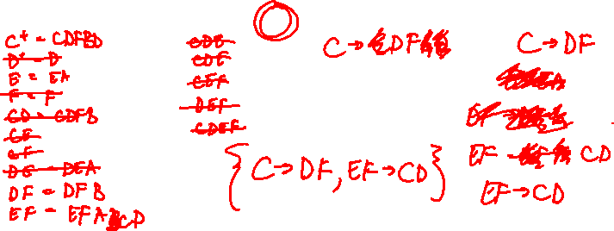
Projection
Suppose we have these FDs:
$$ABE→CF, DF→BD, C→DF, E→A, AF→B$$
Project the FDs onto attributes $R_{4}(CDEF)$.

Slide 12
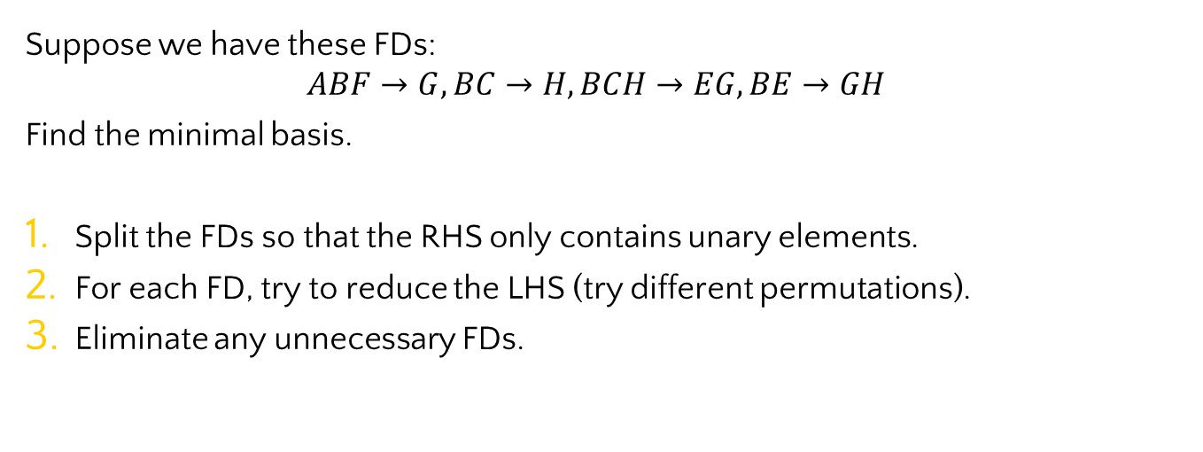

Minimal Basis
Suppose we have these FDs:
$$ABF→G, BC→H, BCH→EG, BE→GH$$
Find the minimal basis.
Split the FDs so that the RHS only contains unary elements.
For each FD, try to reduce the LHS (try different permutations).
Eliminate any unnecessary FDs.

Slide 13

Minimal Basis
Suppose we have these FDs:
$$ABF→G, BC→H, BCH→EG, BE→GH$$
Find the minimal basis.
Split the FDs so that the RHS only contains unary elements.

Slide 14

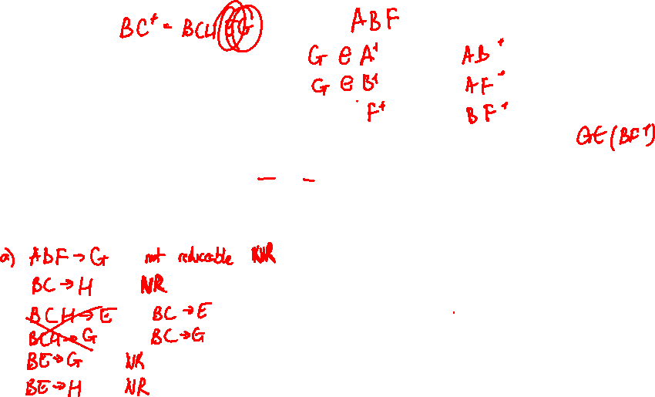
Minimal Basis
Suppose we have these FDs:
$$ABF→G, BC→H, BCH→EG, BE→GH$$
Find the minimal basis.
For each FD, try to reduce the LHS (try different permutations).

Slide 15

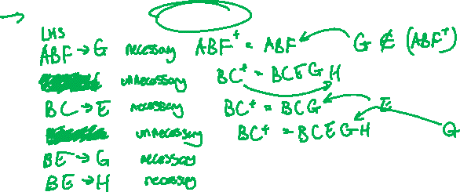
Minimal Basis
Suppose we have these FDs:
$$ABF→G, BC→H, BCH→EG, BE→GH$$
Find the minimal basis.
Eliminate any unnecessary FDs.

Slide 16

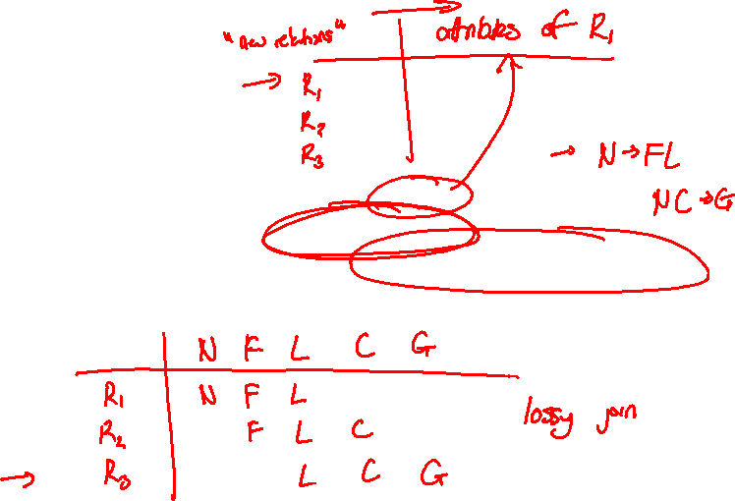
Chase Test
Suppose we have a relation on attributes $NFLCG$ with these FDs:
$$N→FL, NC→G$$
Suppose we decompose into relations $R_{1}(NF)$, $R_{2}(FLC)$ and $R_{3}(LCG)$.
Use the Chase Test to determine whether this is a lossless-join decomposition.

Slide 17

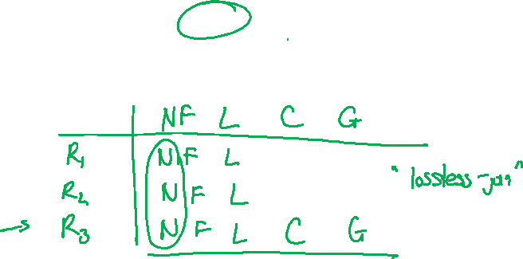
Chase Test
Suppose we have a relation on attributes $NFLCG$ with these FDs:
$$N→FL, NC→G$$
Suppose we decompose into relations $R_{1}(NF)$, $R_{2}(NL)$ and $R_{3}(NCG)$.
Use the Chase Test to determine whether this is a lossless-join decomposition.

Slide 18

Chase Test
Suppose we have a relation on attributes $NFLCG$ with these FDs:
$$N→FL, NC→G$$
Suppose we decompose into relations $R_{1}(NFC)$ and $R_{2}(NLG)$.
Use the Chase Test to determine whether this is a lossless-join decomposition.

Slide 19

Chase Test
Suppose we have a relation on attributes $ABCDEF$ and it is to be decomposed into relations $ABCD$ and $DEF.$
Invent a set of FDs that would make this a lossless-join decomposition.

Slide 20

Chase Test
Suppose we have a relation on attributes $ABCDEF$ and it is to be decomposed into relations $ABCD$ and $DEF.$
Invent a set of three FDs that would make this is a lossy-join decomposition.

Slide 21
Thanks!
Any questions ?
You can find me at
ta.kthisiscvpv.com
charles.xu@mail.utoronto.ca

